Slide 1
Maven
It’s a build tool.
Dependency management framework.
Project management tool
Ant is build tool where we have write script manually so it will very difficult to write 1000 lines..

Slide 2
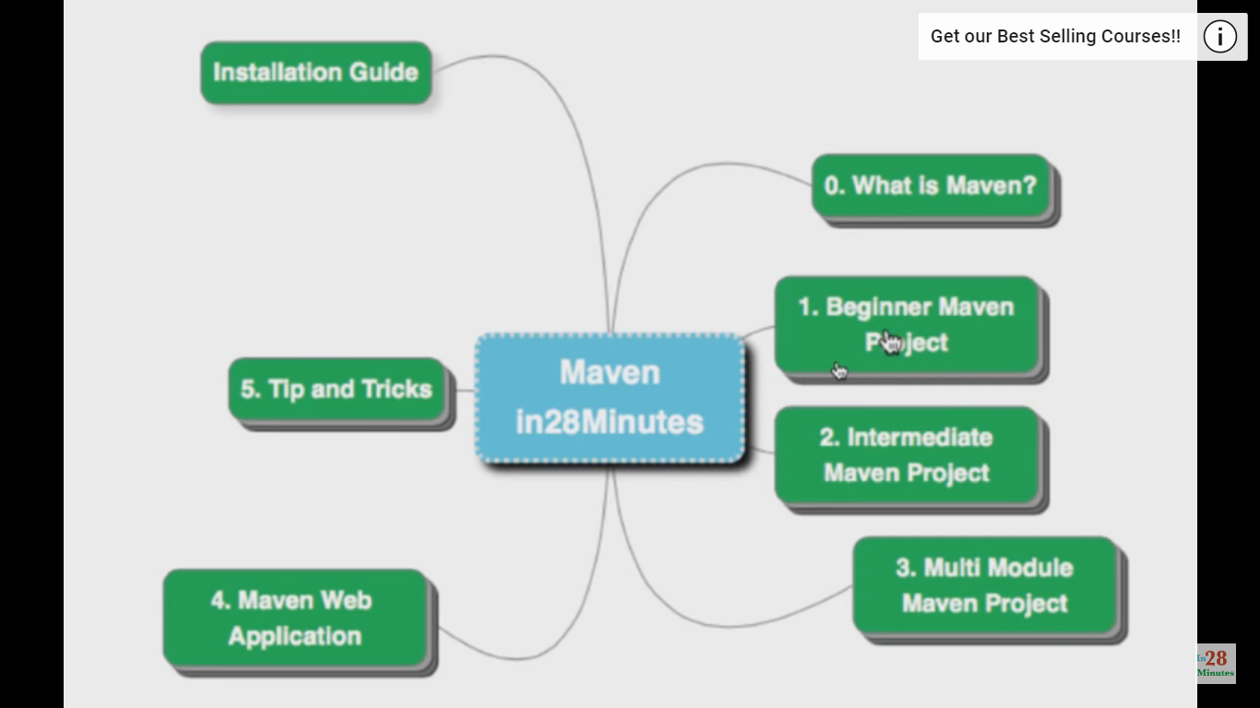

Slide 3
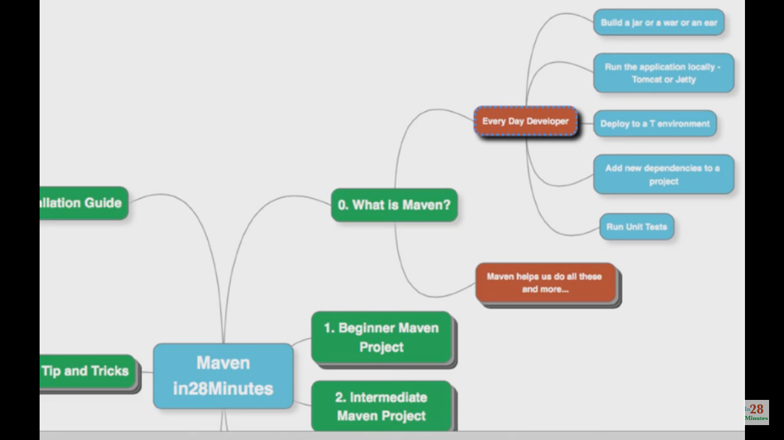

Slide 4
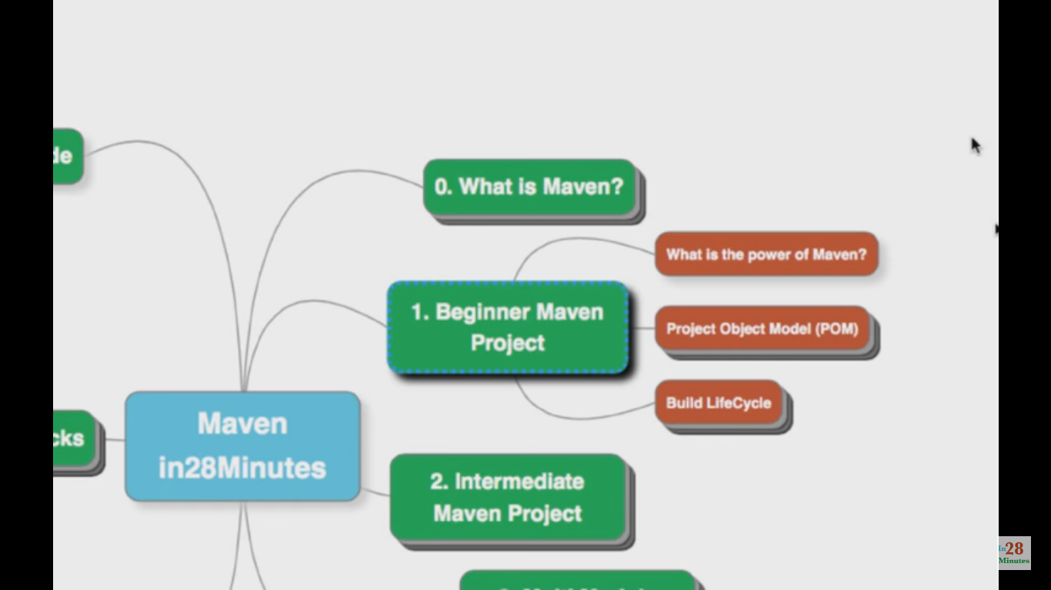

Slide 5
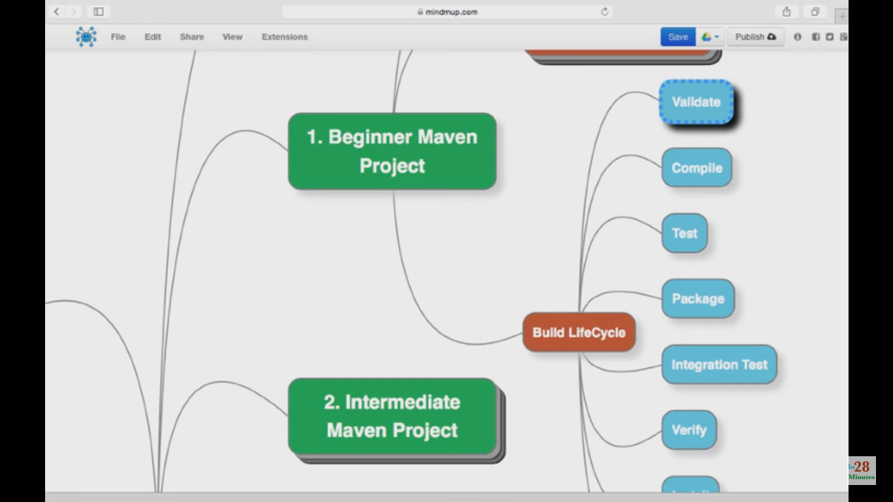

Slide 6
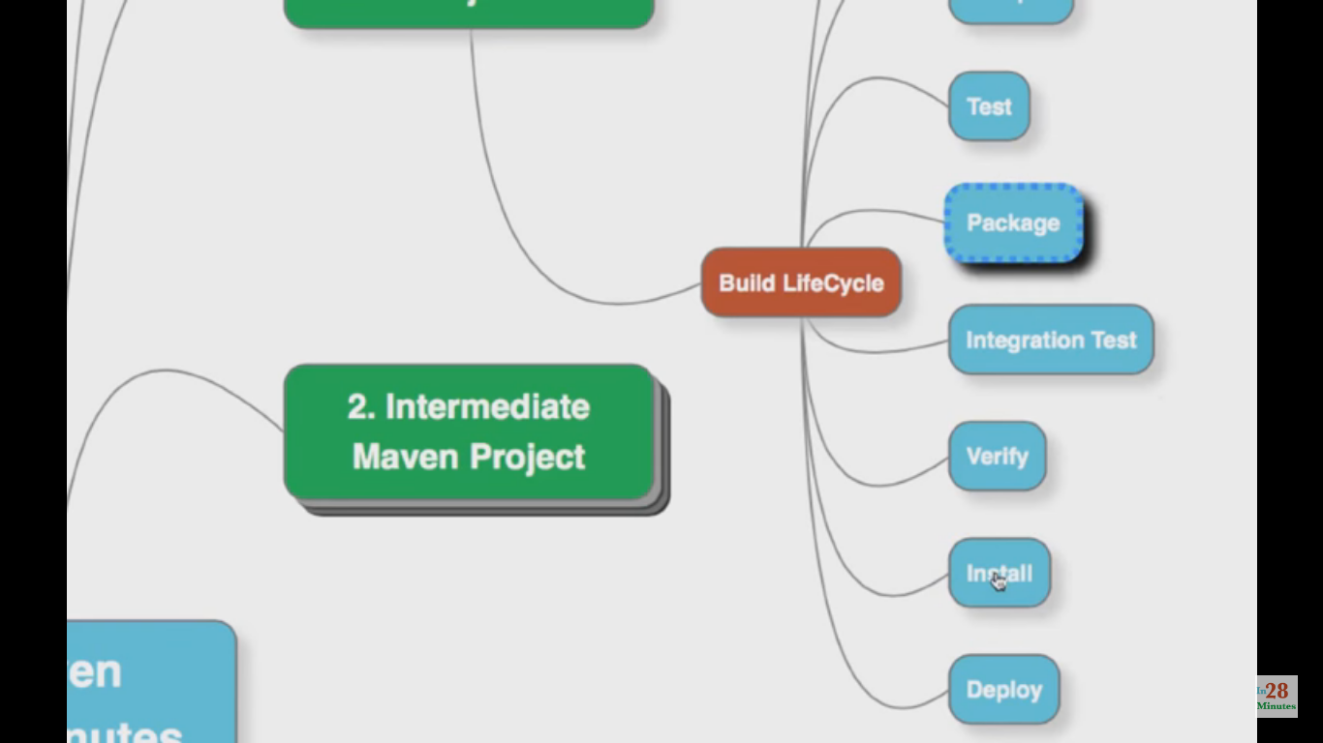

Slide 7
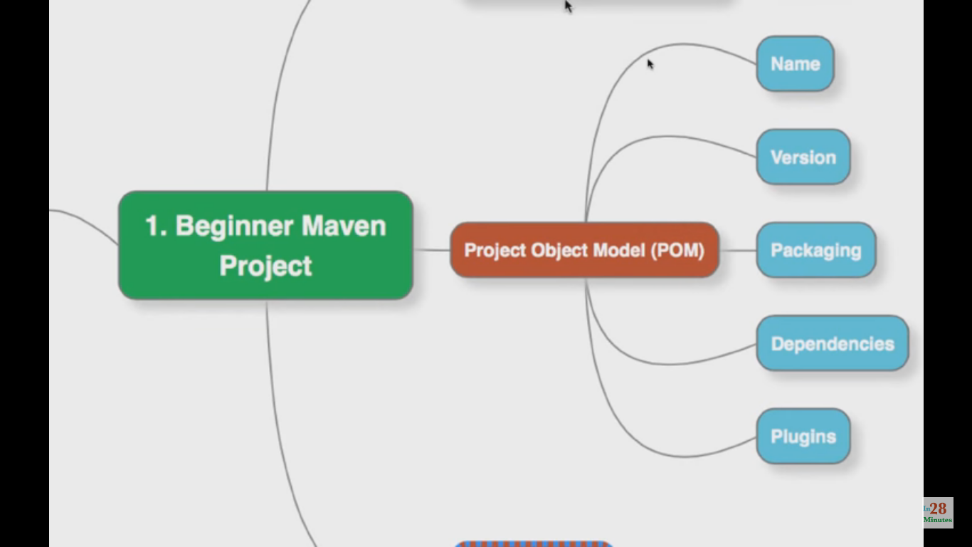

Slide 8
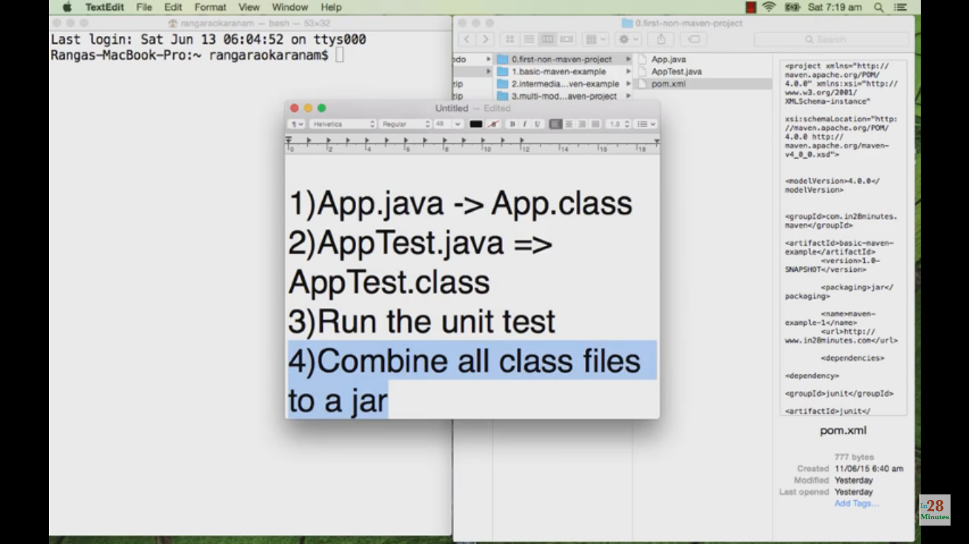

Slide 9
Common problems and activities
Multiple jars
Dependencies and versions
Project structures
Build,publishing and deploying

Slide 10
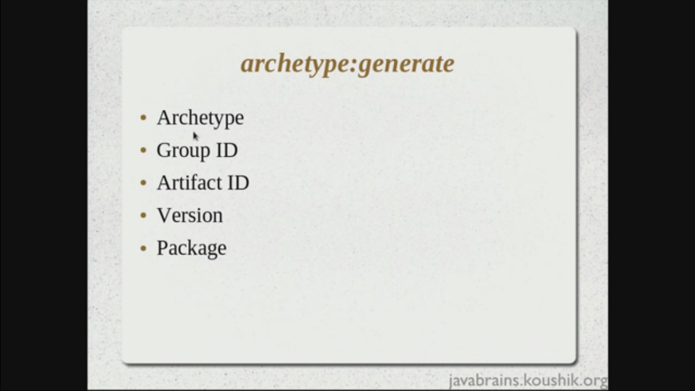

Slide 11
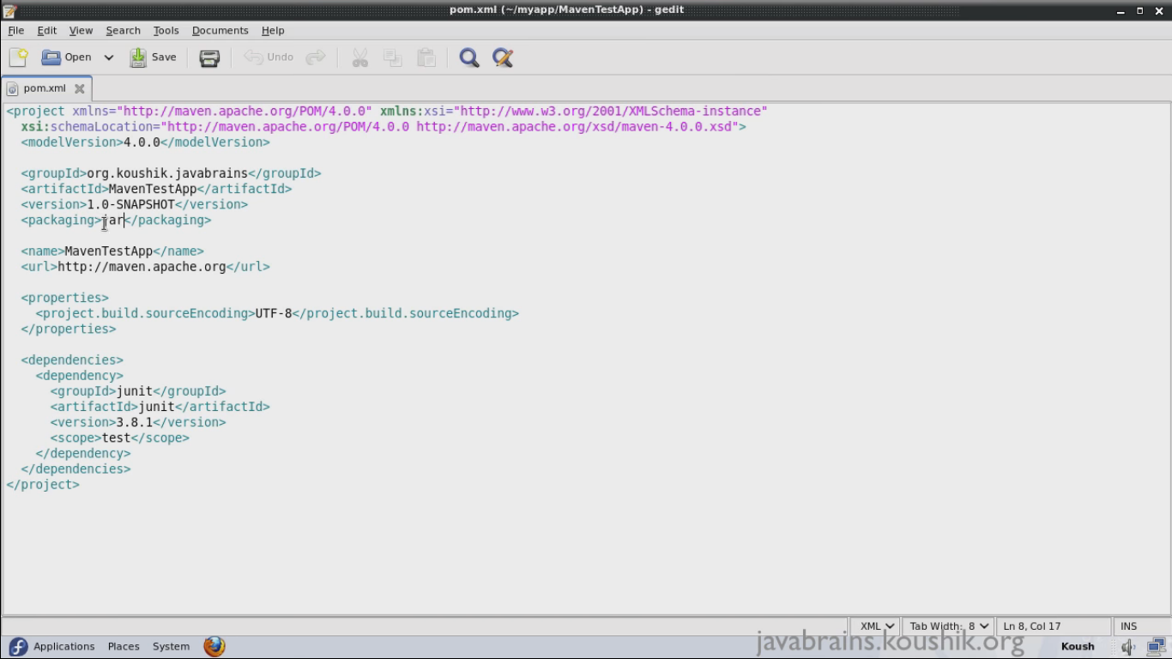

Slide 12
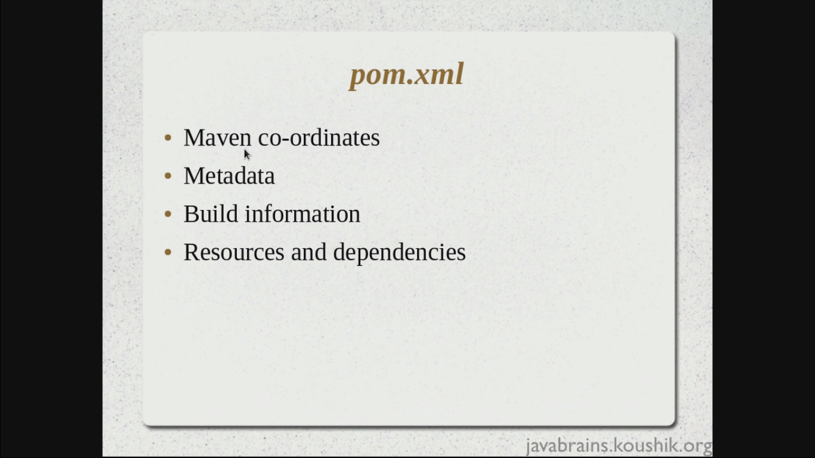

Slide 13
Some commands
>mvn compile
>mvn test
>mvn package
>mvn install
>mvn deploy
>mvn clean//delete target folder
>java –cp target/MavenTestApp.jar com.jspider.vikash.App
>mvn jetty:run
> mvn tomcat7:run
>mvn eclipse: eclipse
>mvn help:effective-pom
>mvn dependency:sources
<mvn help:effective-settings //where is my local repositry
>mvn archetype:generate

Slide 14
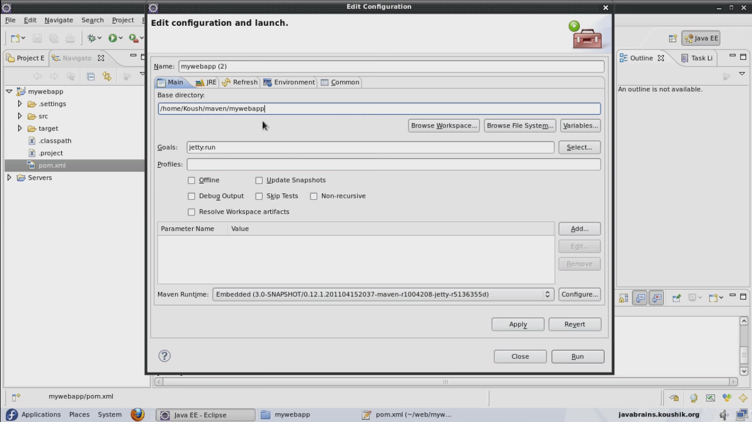

Slide 15
